Slide 1
Four People on a Rickety Bridge
Four people need to cross a rickety bridge at night.
Unfortunately, they have only one torch and the bridge is too dangerous to cross without one.
The bridge is only strong enough to support two people at a time.
Not all people take the same time to cross the bridge. Times for each person: 1 min, 2 mins, 5 mins and 10 mins.
What is the shortest time needed for all four of them to cross the bridge?

Slide 2
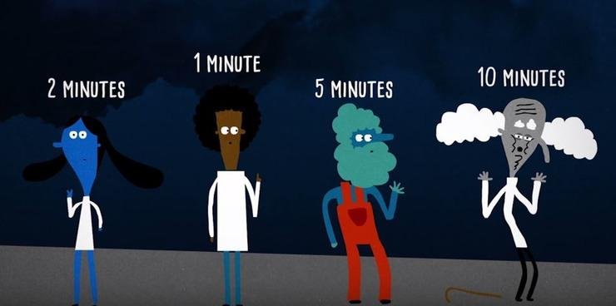

Slide 3
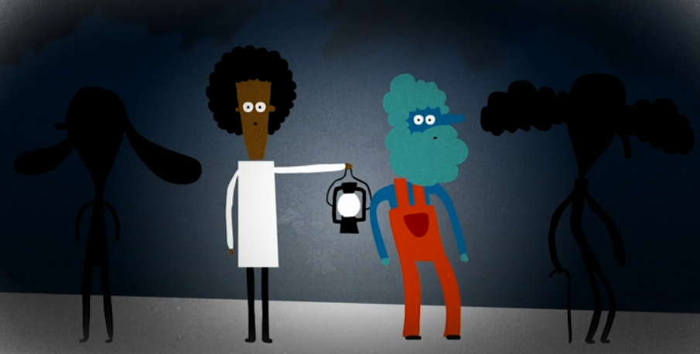

Slide 4
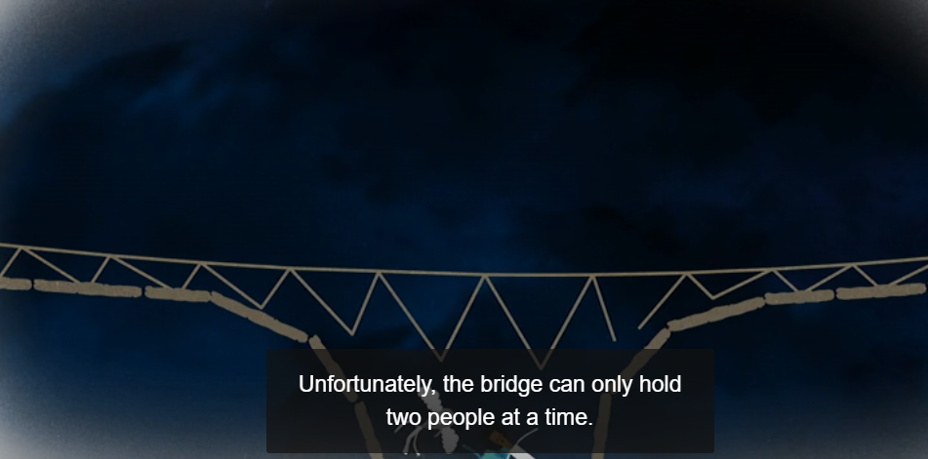
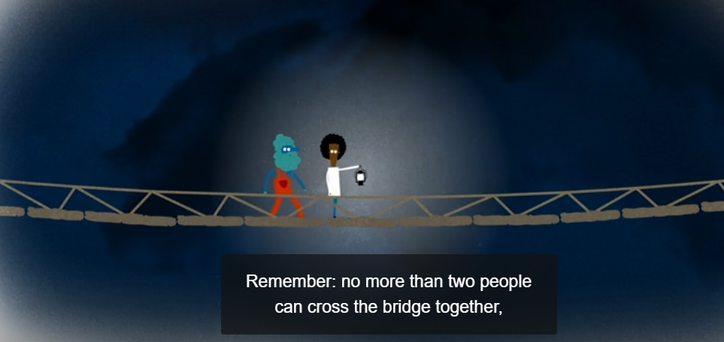

Slide 5
Idea?

Slide 6
1,2
2,5,10
1
1, 5
1, 5,10
2
1,10
1,2,5,10
Nil
1,2, 10
5
2,5
1,2,5
10
2,10
5,10
All possible configurations of the starting shore

Slide 7

1,2
2,5,10
1
1, 5
1, 5,10
2
1,10
1,2,5,10
Nil
1,2, 10
5
2,5
1,2,5
10
2,10
5,10
All possible configurations of the starting shore

Slide 8
Four People on a Rickety Bridge
Four people need to cross a rickety bridge at night. Unfortunately, they have only one torch and the bridge is too dangerous to cross without one. The bridge is only strong enough to support two people at a time. Not all people take the same time to cross the bridge. Times for each person: 1 min, 2 mins, 5 mins and 10 mins. What is the shortest time needed for all four of them to cross the bridge?

Slide 9
Discuss?

Slide 10

1,2
1,2
With a torch at the starting shore
2,5,10
2,5,10
1
1
1, 5
1, 5
Without a torch at the starting shore
1, 5,10
1, 5,10
2
2
1,10
1,10
1,2,5,10
1,2,5,10
Nil
Nil
1,2, 10
1,2, 10
5
5
2,5
2,5
1,2,5
1,2,5
10
10
2,10
2,10
5,10
5,10
All possible configurations of the starting shore
With and without the torchlight

Slide 11
1,2
1
5
5
2
5
1,2,5
2
5
2
1, 5
1
2,5
You can walk from a state with a torch to a state without

Slide 12
1,2
1
5
5
2
5
1,2,5
2
5
2
1, 5
1
2,5
You can walk from a state with a torch to a state without or vice versa

Slide 13
1,2
1,2
Run Dijkstra's algorithm !!!!
2,5,10
2,5,10
1
1
1, 5
1, 5
1
10
2
1, 5,10
1, 5,10
2
2
1,10
1,10
1,2,5,10
1,2,5,10
Nil
Nil
2
1,2, 10
1,2, 10
5
5
2,5
2,5
2
1,2,5
1,2,5
10
10
2,10
2,10
5,10
5,10

Slide 14
Driving in Manhattan
You are driving in a city in Manhattan
With every road goes either NS or WE
Vertical or horizontal only
Moreover, your car is kind of broken
You can ONLY go straight or turn left a each junction
And you cannot turn right

Slide 15
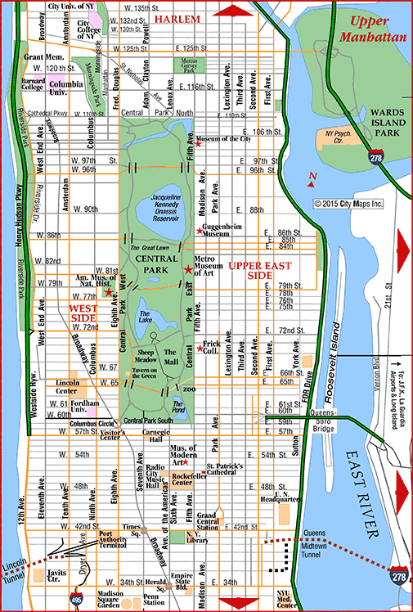

Some roads are blocked

Slide 16

G
S

Slide 17
How?
G
S
Notes:
model each junction as four nodes, each node represent the junction and where does the car coming from. The out going edge will be only going straight and left

